Slide 1

Skill Barter Android APP
By Noa Binenbaum and Jenny Kapul
Guided by Hovav Gazit

Slide 2
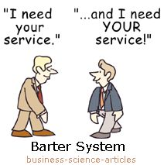

Slide 3
Motivation
Skills and services exchange
!Money
No need in “favors”
Improve your skills and acquire new ones
Meet new people based on interests
Notes:
Create a new platform for skills and services exchange free of charge
Gain points by offering services based on your skills
Receive services in exchange for point gained
Supervise the quality of services offered by sustaining up to date ranking system
Eliminate completely the need of money exchange between users
Allows flexible and constantly adjustable schedule for services offered

Slide 4





Implementation Plan
Native Java
Android Studio IDE
Firebase framework
Google maps and calendar services
UX/UI design

Slide 5
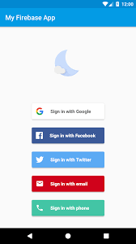
Features
Skill Barter App
Authentication
Notes:
Easy authentication integrating Facebook, Google, Tweeter accounts
Allow sign-up for Technion students only (by Technion e-mail verification)
Each user can constantly change and modify services offered by him and his interests
Set the location of offered services
Set for each service offered the amount of requested points per service unit
Advanced search with filters:
By field / location (static or dynamic) / ranking etc
Ranking and dispute resolution system to increase users satisfaction
The ranking is mutual – both the user offering the service and the user receiving one
Instant messaging system – for secure and easy interaction between users

Slide 6
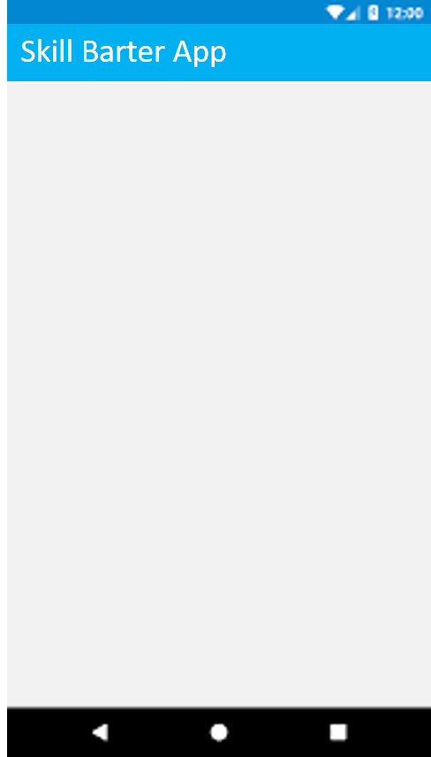
Features
Authentication
Technion only
Technion Authentication
Please enter your valid Technion e-mail address
Send
Notes:
Easy authentication integrating Facebook, Google, Tweeter accounts
Allow sign-up for Technion students only (by Technion e-mail verification)
Each user can constantly change and modify services offered by him and his interests
Set the location of offered services
Set for each service offered the amount of requested points per service unit
Advanced search with filters:
By field / location (static or dynamic) / ranking etc
Ranking and dispute resolution system to increase users satisfaction
The ranking is mutual – both the user offering the service and the user receiving one
Instant messaging system – for secure and easy interaction between users

Slide 7




Features
Authentication
Technion students only
User profile details
User Information
User Information
First Name
Please attach recent and recognizable photo of yourself
*
Last Name
*
Birthday
*
Phone number
*
Address
*
Female Male
Prev
Next
Prev
Next
Notes:
Easy authentication integrating Facebook, Google, Tweeter accounts
Allow sign-up for Technion students only (by Technion e-mail verification)
Each user can constantly change and modify services offered by him and his interests
Set the location of offered services
Set for each service offered the amount of requested points per service unit
Advanced search with filters:
By field / location (static or dynamic) / ranking etc
Ranking and dispute resolution system to increase users satisfaction
The ranking is mutual – both the user offering the service and the user receiving one
Instant messaging system – for secure and easy interaction between users

Slide 8


Features
Skill Barter App
Skill Barter App
Authentication
Technion students only
User profile details
Your Skills:
Your Skills:
Piano
Cooking
Piano
Cooking
Choose category…
Sports
Choose skill…
Choose skill…
Cycling
Dance
Swimming
Tennis
Yoga
Add
Prev
Next
Prev
Next
Notes:
Easy authentication integrating Facebook, Google, Tweeter accounts
Allow sign-up for Technion students only (by Technion e-mail verification)
Each user can constantly change and modify services offered by him and his interests
Set the location of offered services
Set for each service offered the amount of requested points per service unit
Advanced search with filters:
By field / location (static or dynamic) / ranking etc
Ranking and dispute resolution system to increase users satisfaction
The ranking is mutual – both the user offering the service and the user receiving one
Instant messaging system – for secure and easy interaction between users

Slide 9
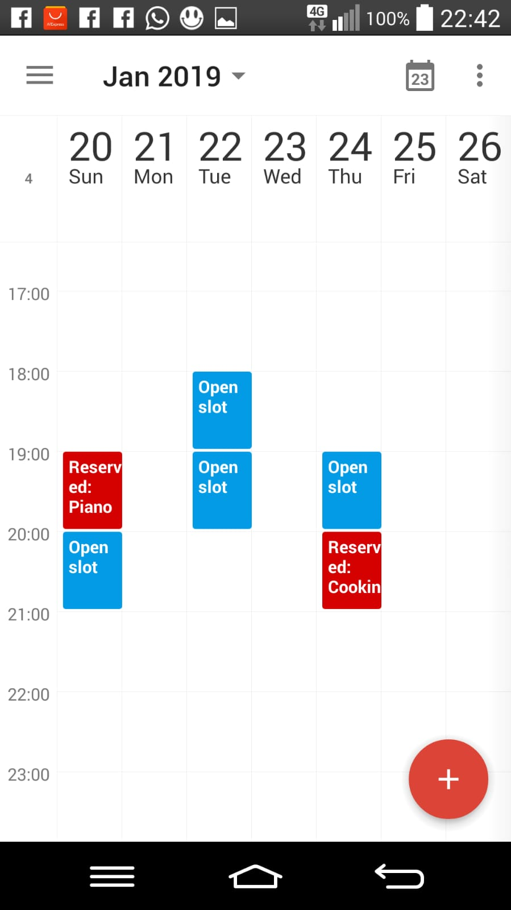
Features
Skill Barter App
Authentication
Technion students only
User profile details
Dynamic schedule
Notes:
Easy authentication integrating Facebook, Google, Tweeter accounts
Allow sign-up for Technion students only (by Technion e-mail verification)
Each user can constantly change and modify services offered by him and his interests
Set the location of offered services
Set for each service offered the amount of requested points per service unit
Advanced search with filters:
By field / location (static or dynamic) / ranking etc
Ranking and dispute resolution system to increase users satisfaction
The ranking is mutual – both the user offering the service and the user receiving one
Instant messaging system – for secure and easy interaction between users

Slide 10






Features
Skill Barter App
Skill Barter App
Authentication
Technion students only
User profile details
Dynamic schedule
Search with filters
Search:
Search:
WHAT
Choose categories…
WHAT
Music, Tutoring
Household Assistance
Music
Sports
Tutoring
Visual Arts
Choose skills…
Choose skills…
WHERE
WHERE
Algebra
Android
Erlang
Piano
Violin
Distance from me:
current default
0 10Km
Distance from me:
current default
0 10Km
WHEN
S M T W T F S
8:00-12:00 12:00-16:00
16:00-20:00 20:00-00:00
WHEN
S M T W T F S
8:00-12:00 12:00-16:00
16:00-20:00 20:00-00:00
Limit by points:
from to
Limit by points:
from to
Notes:
Easy authentication integrating Facebook, Google, Tweeter accounts
Allow sign-up for Technion students only (by Technion e-mail verification)
Each user can constantly change and modify services offered by him and his interests
Set the location of offered services
Set for each service offered the amount of requested points per service unit
Advanced search with filters:
By field / location (static or dynamic) / ranking etc
Ranking and dispute resolution system to increase users satisfaction
The ranking is mutual – both the user offering the service and the user receiving one
Instant messaging system – for secure and easy interaction between users

Slide 11

Features
Authentication
Technion students only
User profile details
Dynamic schedule
Search with filters
Skill Barter App
Skill Barter App
Search:
Results:
Sort
WHAT
Music, Tutoring
By distance
By points
Tutoring – Erlang 0.0 Km
Hovav Gazit
23
Android, Erlang, Piano
Tutoring - Android 0.0 Km
Victor Kulikov
23
WHERE
Distance from me:
current default
0 3.3Km
Tutoring – Algebra 1.3 Km
Aliza Malek
23
Music – Piano. 2.1 Km
Ludwig van Beethoven
99
WHEN
S M T W T F S
8:00-12:00 12:00-16:00
16:00-20:00 20:00-00:00
Limit by points:
from to
Select and click Next for more Information
Next
Notes:
Easy authentication integrating Facebook, Google, Tweeter accounts
Allow sign-up for Technion students only (by Technion e-mail verification)
Each user can constantly change and modify services offered by him and his interests
Set the location of offered services
Set for each service offered the amount of requested points per service unit
Advanced search with filters:
By field / location (static or dynamic) / ranking etc
Ranking and dispute resolution system to increase users satisfaction
The ranking is mutual – both the user offering the service and the user receiving one
Instant messaging system – for secure and easy interaction between users

Slide 12



Features
Authentication
Technion students only
User profile details
Dynamic schedule
Search with filters
Skill Barter App
Skill Barter App
Manage Skills
History
Edit Profile
Sign Out
noabinen
1200
noabinen
1200
Up next:
Up next:
Tutoring – Erlang Tomorrow
Hovav Gazit 27/03/19
23 16:30
Tutoring – Erlang Tomorrow
Hovav Gazit 27/03/19
23 16:30
Tutoring - Android Next week
Victor Kulikov 4/4/19
23 18:00
Tutoring - Android Next week
Victor Kulikov 4/4/19
23 18:00
Tutoring – Algebra Pending
Aliza Malek 4/4/19
23 19:30
Tutoring – Algebra Pending
Aliza Malek 4/4/19
23 19:30
Notes:
Easy authentication integrating Facebook, Google, Tweeter accounts
Allow sign-up for Technion students only (by Technion e-mail verification)
Each user can constantly change and modify services offered by him and his interests
Set the location of offered services
Set for each service offered the amount of requested points per service unit
Advanced search with filters:
By field / location (static or dynamic) / ranking etc
Ranking and dispute resolution system to increase users satisfaction
The ranking is mutual – both the user offering the service and the user receiving one
Instant messaging system – for secure and easy interaction between users

Slide 13
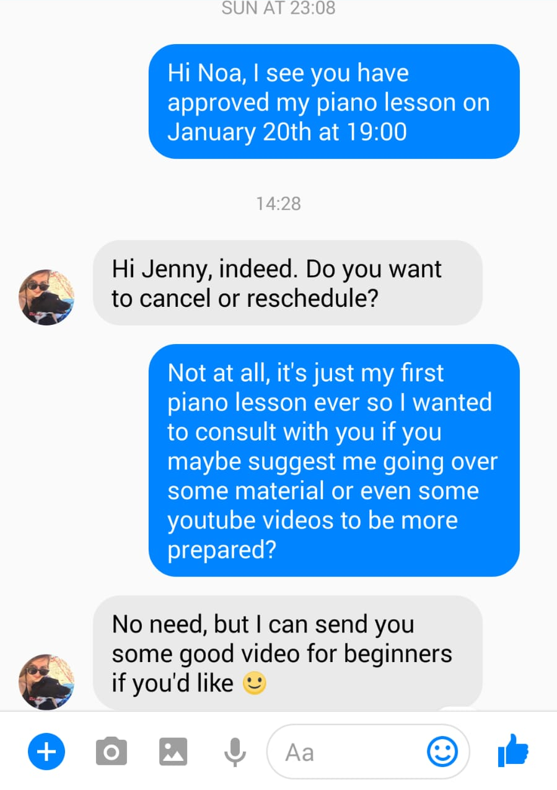
Features
Skill Barter App
Authentication
Technion students only
User profile details
Dynamic schedule
Search with filters
In-app messenger
Notes:
Easy authentication integrating Facebook, Google, Tweeter accounts
Allow sign-up for Technion students only (by Technion e-mail verification)
Each user can constantly change and modify services offered by him and his interests
Set the location of offered services
Set for each service offered the amount of requested points per service unit
Advanced search with filters:
By field / location (static or dynamic) / ranking etc
Ranking and dispute resolution system to increase users satisfaction
The ranking is mutual – both the user offering the service and the user receiving one
Instant messaging system – for secure and easy interaction between users

Slide 14
Optional Features
Ranking
Dispute resolution
Administrator interface
Addition of new skill by user
Notes:
Easy authentication integrating Facebook, Google, Tweeter accounts
Allow sign-up for Technion students only (by Technion e-mail verification)
Each user can constantly change and modify services offered by him and his interests
Set the location of offered services
Set for each service offered the amount of requested points per service unit
Advanced search with filters:
By field / location (static or dynamic) / ranking etc
Ranking and dispute resolution system to increase users satisfaction
The ranking is mutual – both the user offering the service and the user receiving one
Instant messaging system – for secure and easy interaction between users

Slide 15

Thank You
Questions?

